Slide 1




Exploratory PEPR
NumPEx
High Performance Numerics for Exascale
Dr J. BOBIN CEA, co-director of NumPEx
Pr M. DAYDE CNRS, co-director of NumPEx
Dr J-Y. BERTHOU INRIA, co-director of NumPEx
Notes:
- Plutot qu’un catalogue de travaux de recherches
- Je detaillerai un pan important de mes travaux en separation de source, particulierement illustratif de mon travail au LCS a la frontiere entre developpements methodologiques et applications en astrophysique.

Slide 2
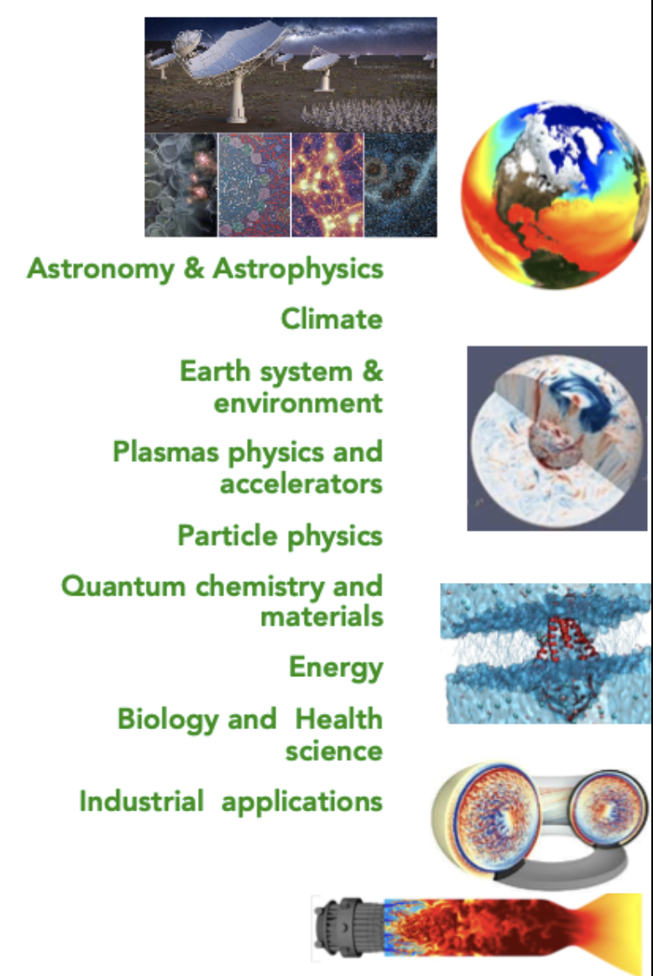
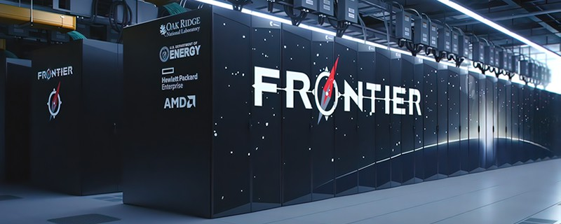
Towards the Exascale: challenges
Software stack
Exascale system
Applications
Preparing the applications for the Exascale era requires
a major effort to re-design the software stack, by co-design
Notes:
- Plutot qu’un catalogue de travaux de recherches
- Je detaillerai un pan important de mes travaux en separation de source, particulierement illustratif de mon travail au LCS a la frontiere entre developpements methodologiques et applications en astrophysique.

Slide 3
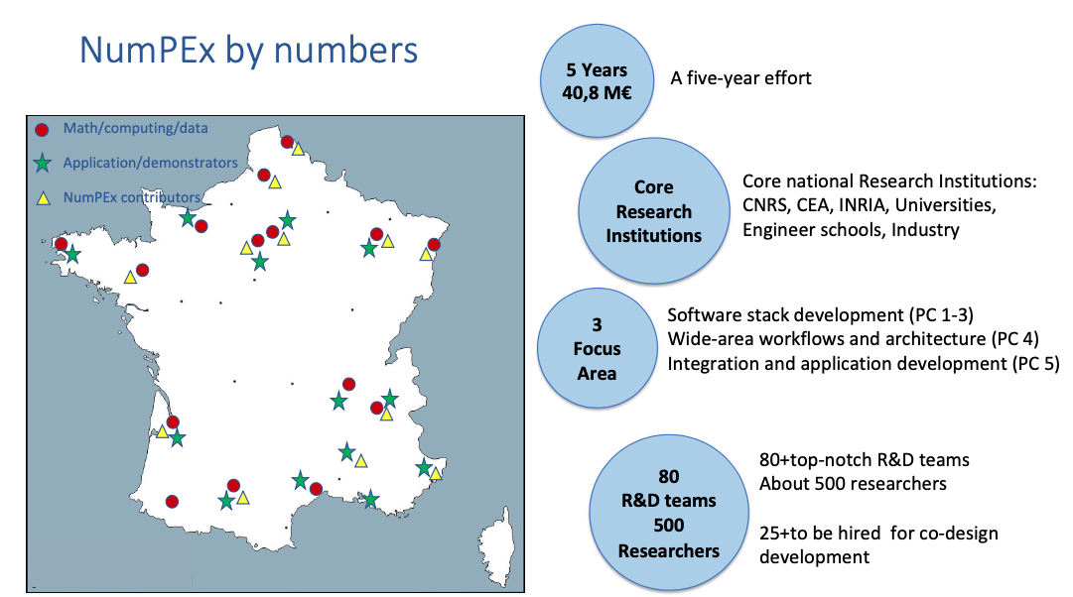
In the national ecosystem
NumPEx as the software/middleware component of France Exascale
Notes:
- Plutot qu’un catalogue de travaux de recherches
- Je detaillerai un pan important de mes travaux en separation de source, particulierement illustratif de mon travail au LCS a la frontiere entre developpements methodologiques et applications en astrophysique.

Slide 4
NumPEx, an overview
Prepare the applications for
the Exascale era
Contribute/accelerate to the emergence of a European Software Stack and strategic applications Exascale capability
Aggregate the French
HPC/HPDA/IA
Community
NumPEx
Accelerate science/engineering-driven
developers training and
software productivity
Integrate/validate co-designed methods/libraires
with demonstrators and strategic appli.
Notes:
- Plutot qu’un catalogue de travaux de recherches
- Je detaillerai un pan important de mes travaux en separation de source, particulierement illustratif de mon travail au LCS a la frontiere entre developpements methodologiques et applications en astrophysique.

Slide 5
NumPEx Organisation
PC1-ExaMA
Methods/Algorithms
for the Exascale
PC2-ExaSoft
PC5-ExaDIP
HPC softwares/tools
for the Exascale
Application-driven
co-design
PC3-ExaDost
Data-oriented softwares/tools
for the Exascale
Applications
PC4-ExaAToW
Architectures/tools for
large-scale workflows
Notes:
- Plutot qu’un catalogue de travaux de recherches
- Je detaillerai un pan important de mes travaux en separation de source, particulierement illustratif de mon travail au LCS a la frontiere entre developpements methodologiques et applications en astrophysique.

Slide 6
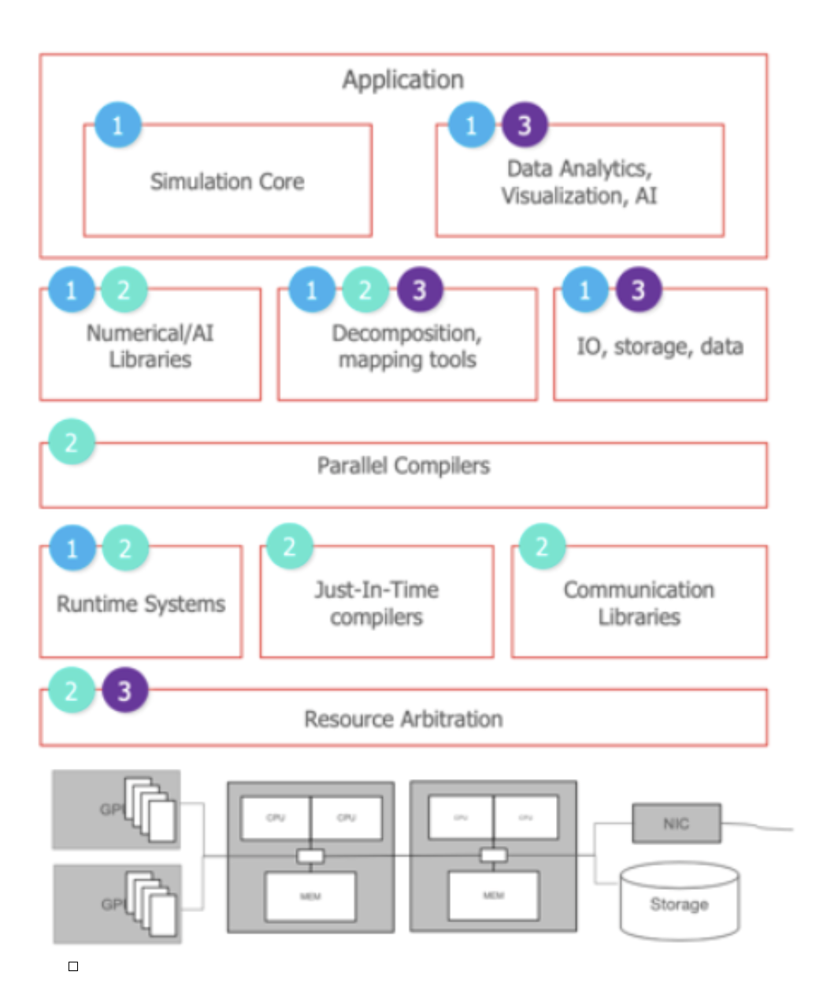
NumPEx software stack
PC1-ExaMA
Methods/Algorithms
for the Exascale
PC2-ExaSoft
HPC softwares/tools
for the Exascale
PC3-ExaDost
Data-oriented softwares/tools
for the Exascale
Notes:
- Plutot qu’un catalogue de travaux de recherches
- Je detaillerai un pan important de mes travaux en separation de source, particulierement illustratif de mon travail au LCS a la frontiere entre developpements methodologiques et applications en astrophysique.

Slide 7
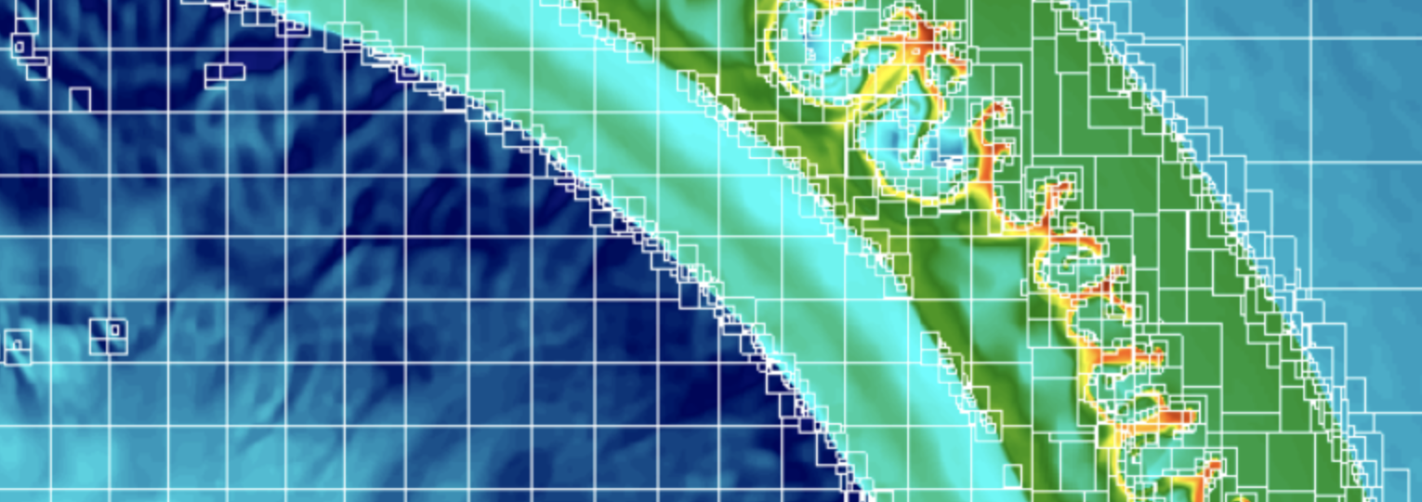
NumPEx, ExaMA
Methods/Algorithms for the Exascale
AMR
Discretization
Reduced order and AI-driven methods
for multi-fidelity modelling
PC1-ExaMA
Linear, multi-linear and coupled solvers
Methods/Algorithms
for the Exascale
Combine data and models, inverse problems
Optimize at Exascale
Quantify uncertainties
Notes:
- Plutot qu’un catalogue de travaux de recherches
- Je detaillerai un pan important de mes travaux en separation de source, particulierement illustratif de mon travail au LCS a la frontiere entre developpements methodologiques et applications en astrophysique.

Slide 8
NumPEx, ExaSoft
HPC software/tools for the Exascale
High-level approaches for developing efficient
and composable parallel software
Just-in-Time code optimization with
continuous feedback loop
PC2-ExaSoft
Runtime Systems at Exascale
HPC softwares/tools
for the Exascale
Portable, scalable numerical
building blocks and software
Performance analysis and prediction
Energy profiling and control
Notes:
- Plutot qu’un catalogue de travaux de recherches
- Je detaillerai un pan important de mes travaux en separation de source, particulierement illustratif de mon travail au LCS a la frontiere entre developpements methodologiques et applications en astrophysique.

Slide 9
NumPEx, ExaDost
Data-oriented sfotwares/tools for the Exascale
Exascale I/O and storage
Exascale in-situ data processing
PC3-ExaDost
Exascale ML-based data analytics
Data-oriented softwares/tools
for the Exascale
Large-scale
numerical
simulations
Scalable
Data analytics
IA
Exascale capacity
Notes:
- Plutot qu’un catalogue de travaux de recherches
- Je detaillerai un pan important de mes travaux en separation de source, particulierement illustratif de mon travail au LCS a la frontiere entre developpements methodologiques et applications en astrophysique.

Slide 10
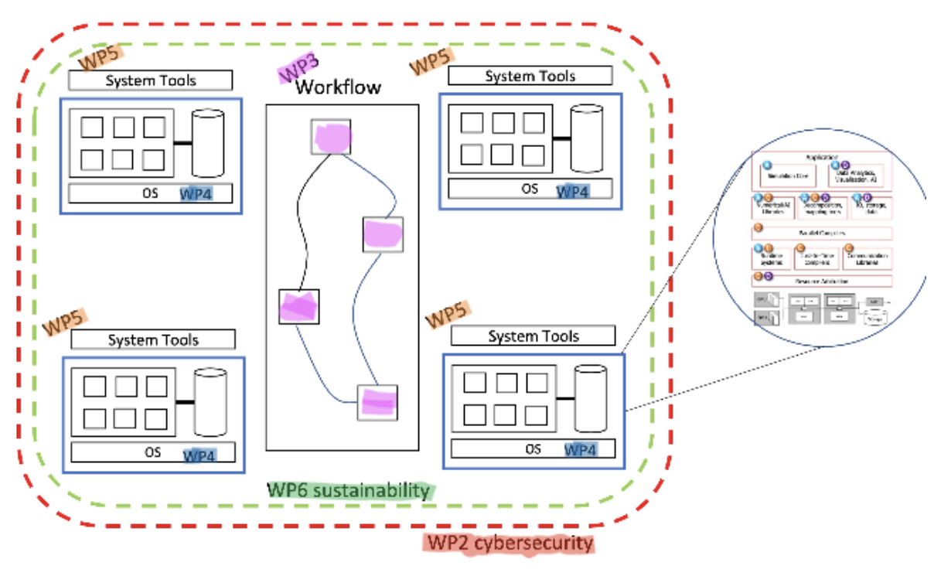
NumPEx, Exa-AToW
Architectures and tools for large-scale workflows
Federation of network, data, and compute resources
Metadata Centric Approach
PC4-ExaAToW
Machine Actionable Data/Project Plan
Architectures/tools for
large-scale workflows
Data Logistic
Application & Workflow Support
Federation Governance
Notes:
- Plutot qu’un catalogue de travaux de recherches
- Je detaillerai un pan important de mes travaux en separation de source, particulierement illustratif de mon travail au LCS a la frontiere entre developpements methodologiques et applications en astrophysique.

Slide 11
NumPEx ExaDIP
Application-driven co-design software development, integration and productivity
Co-design management
Co-design
PC5-ExaDIP
Integration and productivity
Application-driven
co-design
Training
Applications
Notes:
- Plutot qu’un catalogue de travaux de recherches
- Je detaillerai un pan important de mes travaux en separation de source, particulierement illustratif de mon travail au LCS a la frontiere entre developpements methodologiques et applications en astrophysique.

Slide 12
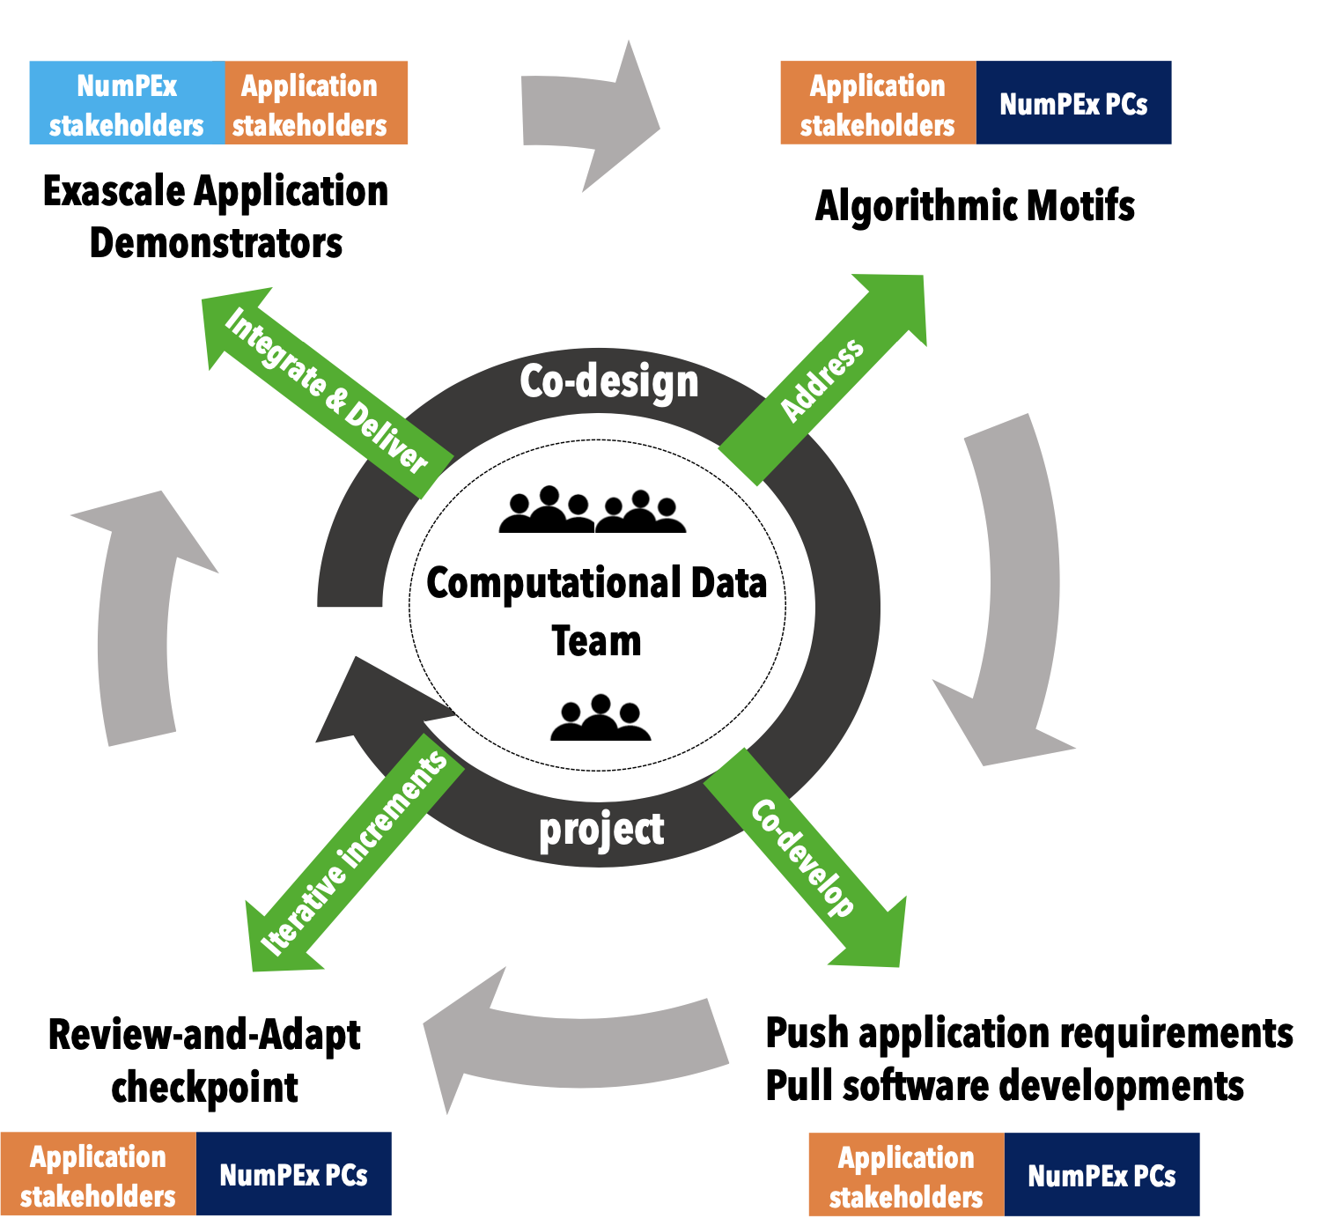
NumPEx, co-design
Application-driven co-design software development, integration and productivity
Identify/develop common/transverse
algorithmic/library motifs
Applications
Notes:
- Plutot qu’un catalogue de travaux de recherches
- Je detaillerai un pan important de mes travaux en separation de source, particulierement illustratif de mon travail au LCS a la frontiere entre developpements methodologiques et applications en astrophysique.

Slide 13
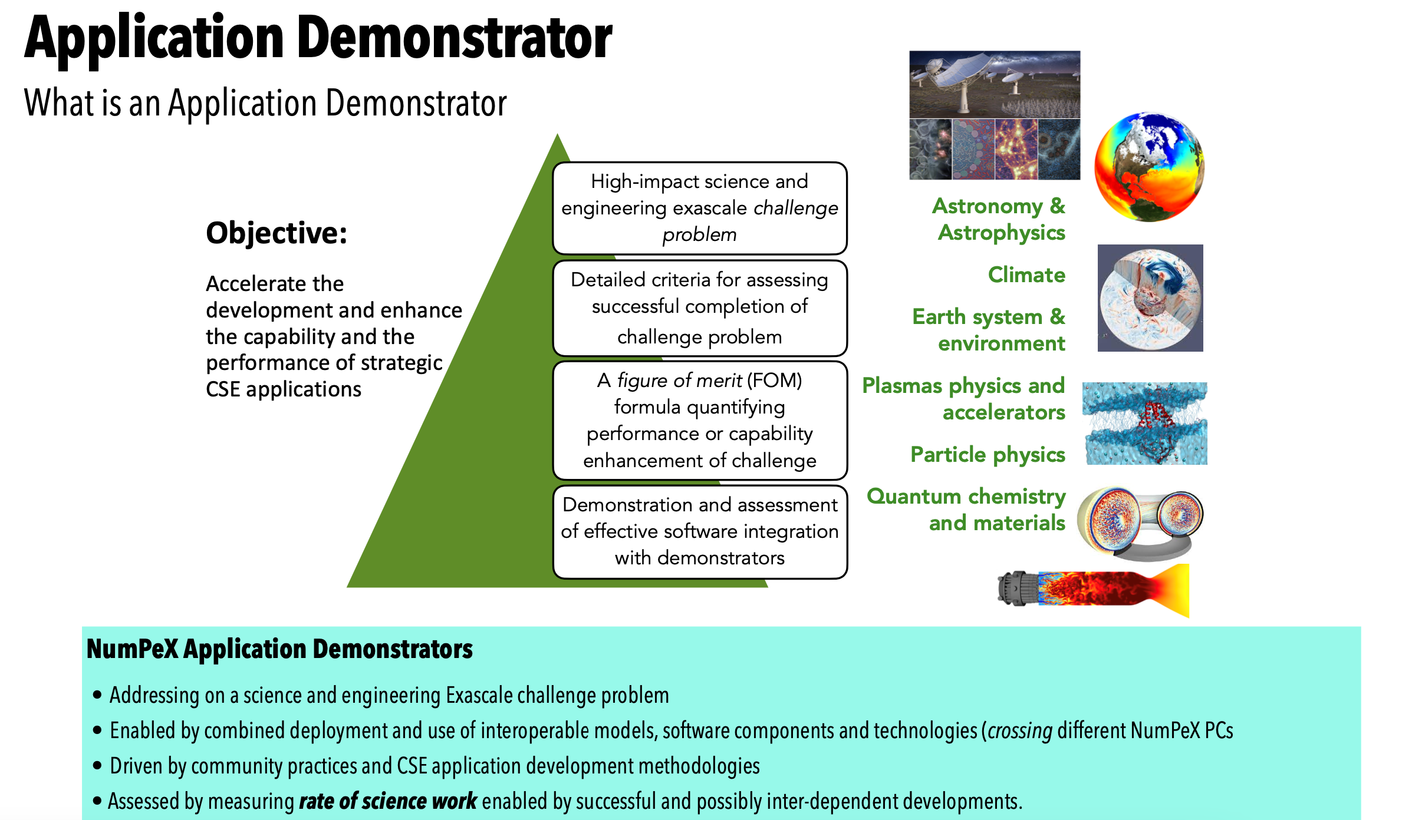
NumPEx, co-design demonstrators
Notes:
- Plutot qu’un catalogue de travaux de recherches
- Je detaillerai un pan important de mes travaux en separation de source, particulierement illustratif de mon travail au LCS a la frontiere entre developpements methodologiques et applications en astrophysique.

Slide 14
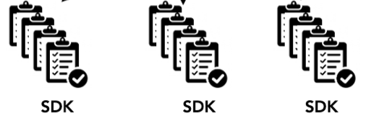
NumPEx, co-design integration/productivity
Application-driven co-design software development, integration and productivity
WP2
PC1
Algorithmic motifs
PC2
PC3
WP3
PC4
Software integration
& delivery
Applications
- Logical application-driven collections of value-added interoperable software components
Integrated and packaged using common meta-builder systems enabling combined deployment of software components as needed by CSE applications
Notes:
- Plutot qu’un catalogue de travaux de recherches
- Je detaillerai un pan important de mes travaux en separation de source, particulierement illustratif de mon travail au LCS a la frontiere entre developpements methodologiques et applications en astrophysique.

Slide 15
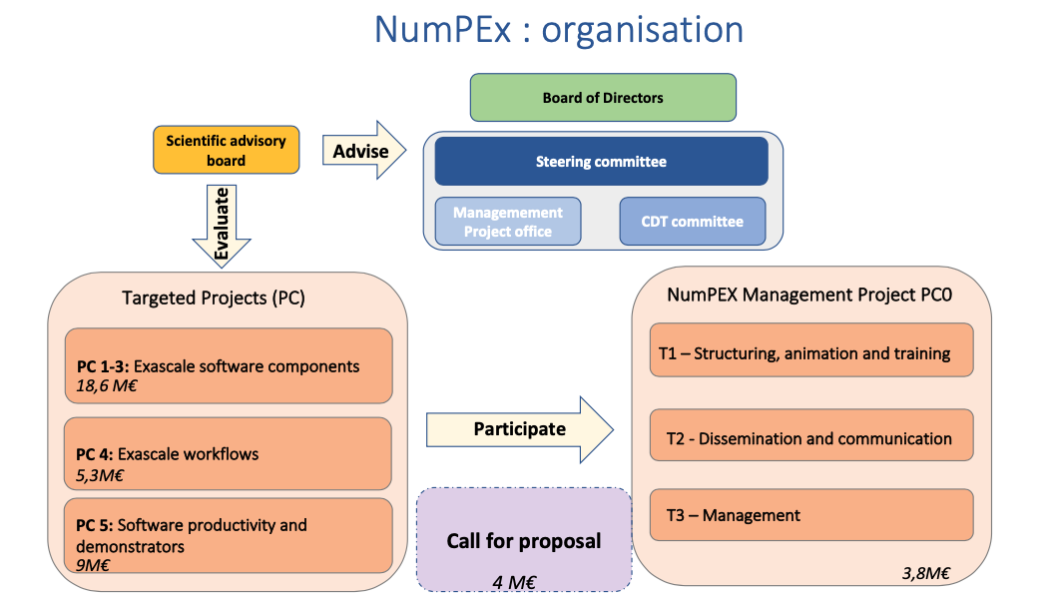
NumPEx, sum-up
Notes:
- Plutot qu’un catalogue de travaux de recherches
- Je detaillerai un pan important de mes travaux en separation de source, particulierement illustratif de mon travail au LCS a la frontiere entre developpements methodologiques et applications en astrophysique.

Slide 16
NumPEx, sum-up
PC1-ExaMA
Call for
proposal
PC0
Methods/Algorithms
for the Exascale
Coordination/Governance
4M€
6.4M€
3.8M€
PC2-ExaSoft
Board of
directors
Steering
committee
HPC softwares/tools
for the Exascale
6.2M€
PC5-ExaDIP
Application-driven
co-design
Project
office
Industrial board
PC3-ExaDost
9M€
Data-oriented softwares/tools
for the Exascale
Programme management
5.9M€
PC4-ExaAToW
Communication/dissemination
Architectures/tools for
large-scale workflows
5.3M€
Training
Notes:
- Plutot qu’un catalogue de travaux de recherches
- Je detaillerai un pan important de mes travaux en separation de source, particulierement illustratif de mon travail au LCS a la frontiere entre developpements methodologiques et applications en astrophysique.

Slide 17
NumPEx, take-away messages
NumPEx is an ambitious program to:
prepare the scientific/engineering applications for the forthcoming HPC syst.
- contribute to the French/European software stack for future Exascale systems
bridge the gap between the computer science/application communities
help building a community for advanced scientific software development
Open to propositions of applicative demonstrators !
Many job openings too!
www.numpex.fr
Notes:
- Plutot qu’un catalogue de travaux de recherches
- Je detaillerai un pan important de mes travaux en separation de source, particulierement illustratif de mon travail au LCS a la frontiere entre developpements methodologiques et applications en astrophysique.

Slide 18
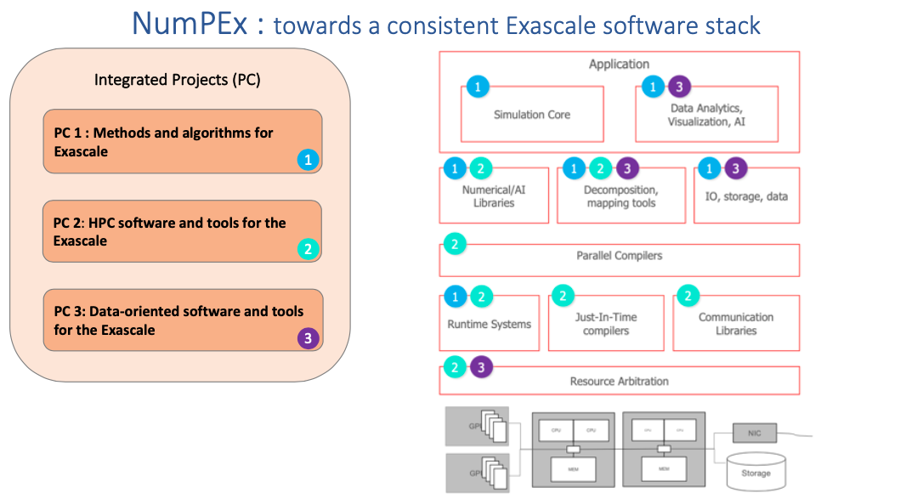
NumPEx: towards a consistent software stack

Slide 19
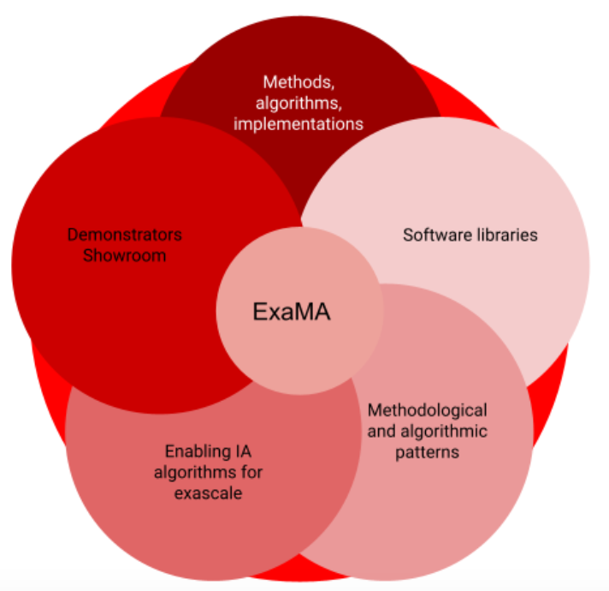
PC1-ExaMA-Methods and algorithms
WP1-Discretization
WP2-Reduced order and AI-driven methods for multi-fidelity modelling
WP3-Linear, multi-linear and coupled solvers at Exascale
WP4-Combine data and models, inverse problems at Exascale
WP5-Optimize at Exascale
WP6-Quantify uncertainties
WP7-Demonstrators

Slide 20
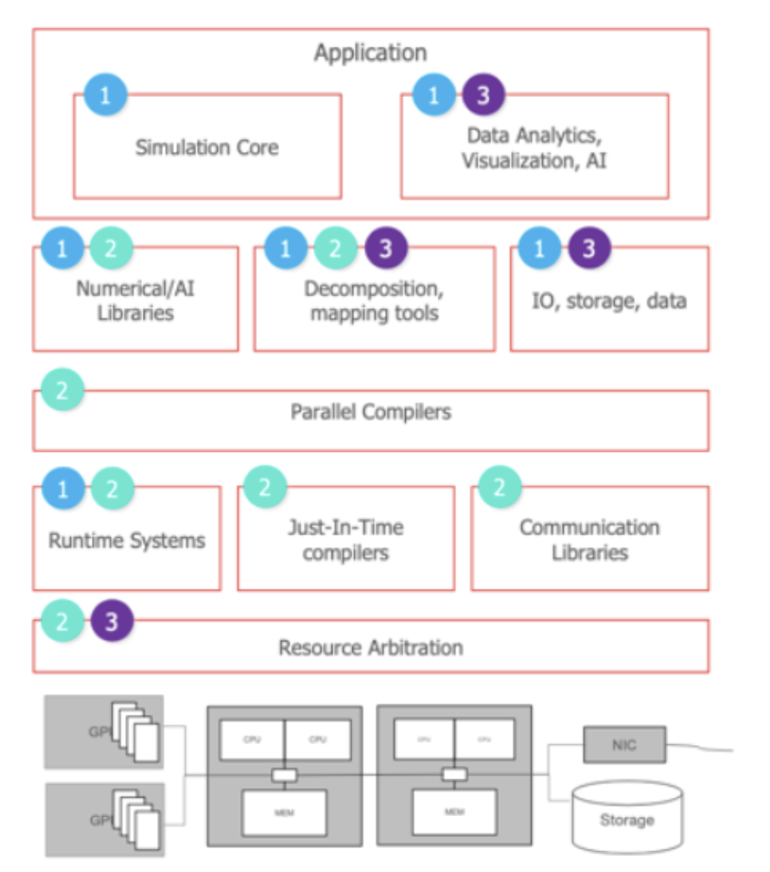
PC2-ExaSOFT-HPC softwares and tools
WP1-High-level approaches for developing efficient and composable parallel software
WP2-Just-in-Time code optimization with continuous feedback loop
WP3-Runtime Systems at Exascale
WP4-Portable, scalable numerical building blocks and software
WP5-Performance analysis and prediction
WP6-Energy profiling and control
WP7-Demonstrators

Slide 21
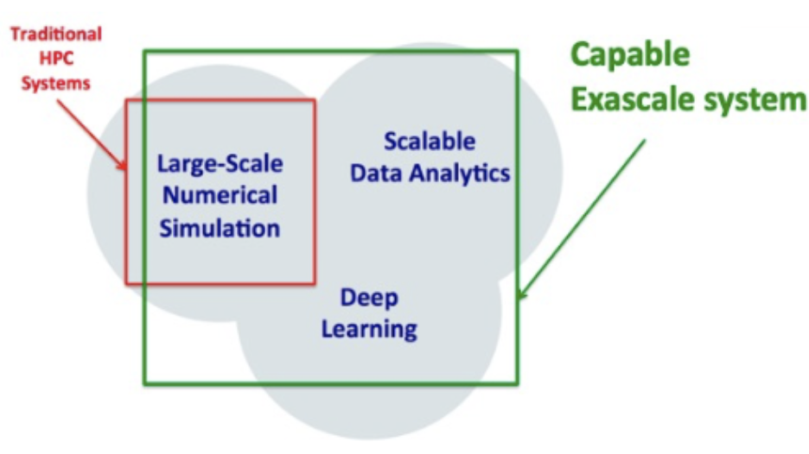
PC3-ExaDOST-Data-oriented softwares and tools
WP1-Exascale I/O and storage
WP2-Exascale in-situ data processing
WP3-Exascale ML-based data analytics
WP4-Demonstrators

Slide 22
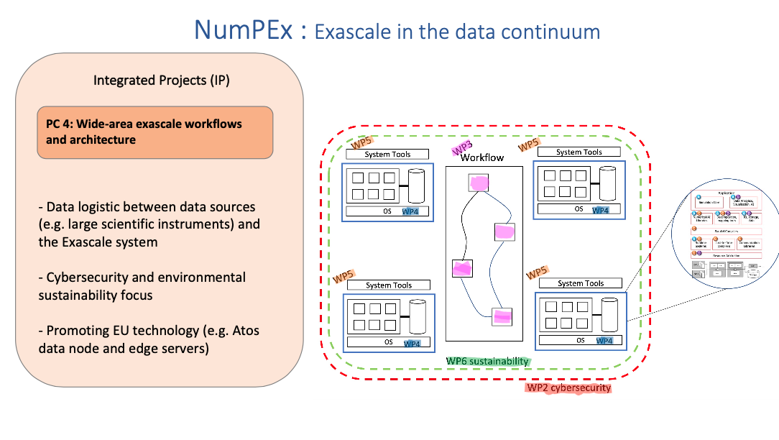
NumPEx: Exascale in the data continuum

Slide 23
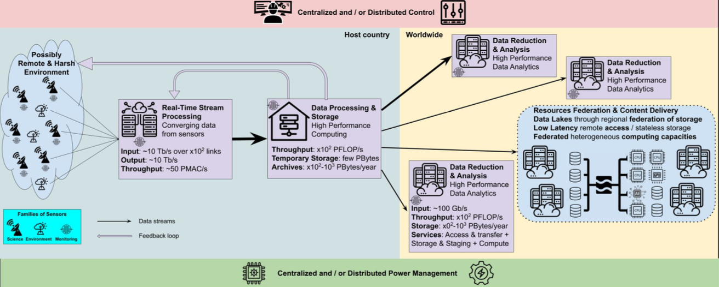
PC4-ExaATOW-Architectures and tools for large-scale workflows
WP1-Federation of network, data, and compute resources
WP2-Metadata Centric Approach
WP3-Machine Actionable Data/Project Plan
WP4-Data Logistic
WP5-Application & Workflow Support
WP6-Federation Governance

Slide 24
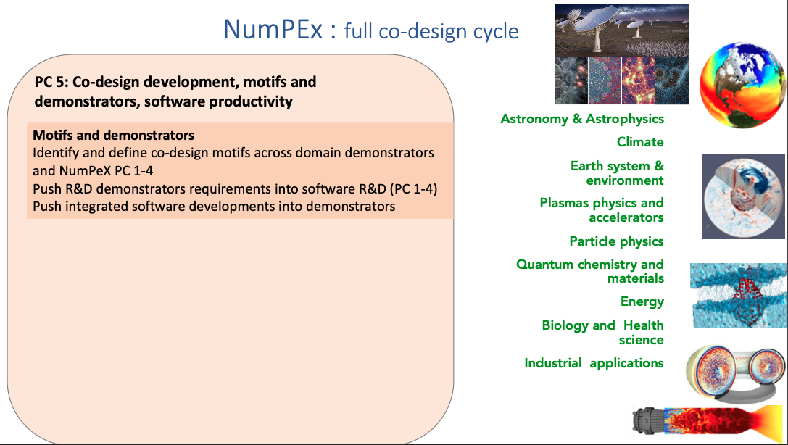
NumPEx: co-design

Slide 25
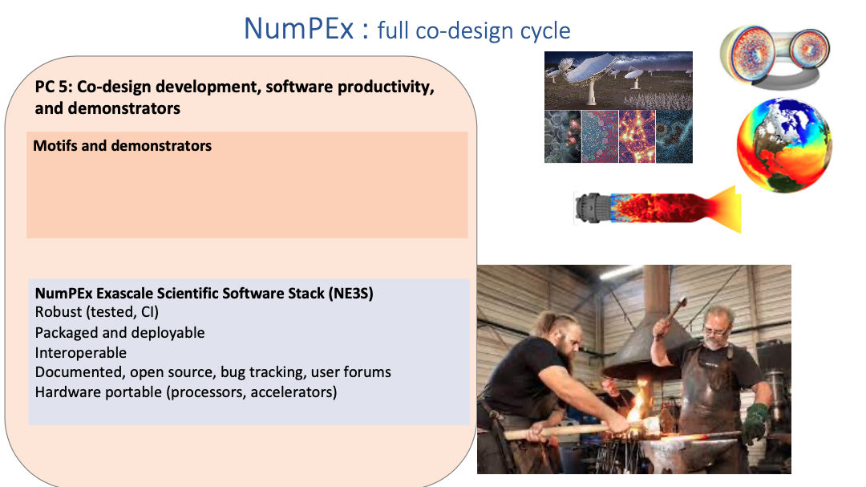
NumPEx: co-design

Slide 26
PC5-ExaDIP-Application-driven co-design software development, integration and productivity
WP1-Co-design management
WP2-Co-design
WP3-Integration and productivity
WP4-Training

Slide 27
Application demonstrator

Slide 28
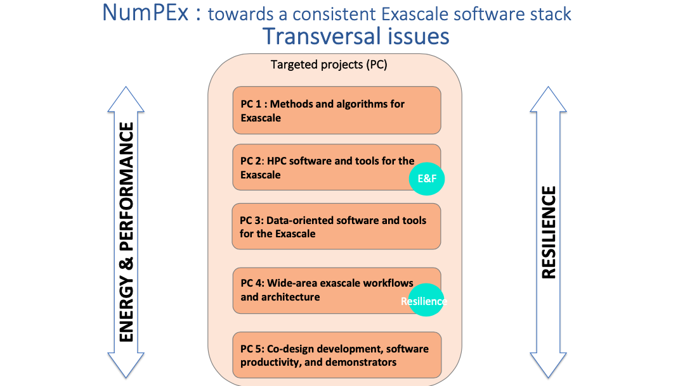
Transversal issues/actions

